Slide 1
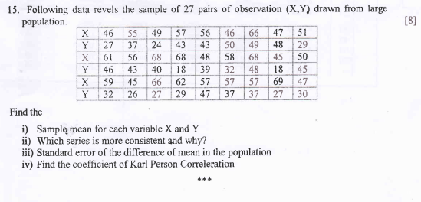

Slide 2
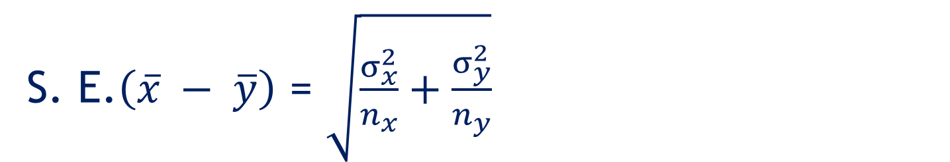
S. E.$\left(\overline{x} − \overline{y}\right)$ = $\sqrt{\frac{σ_{x}^{2}}{n_{x}}+\frac{σ_{y}^{2}}{n_{y}}}$

Slide 3
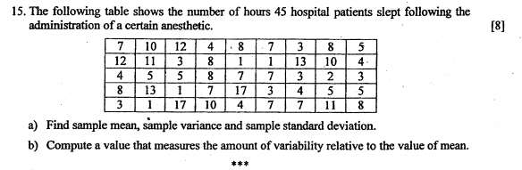

Slide 4
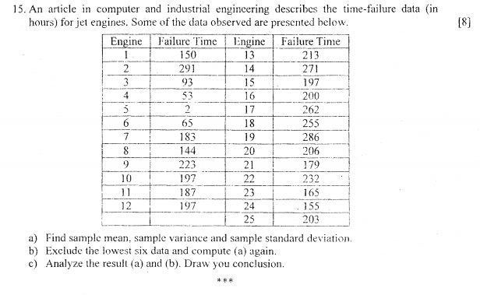

Slide 5
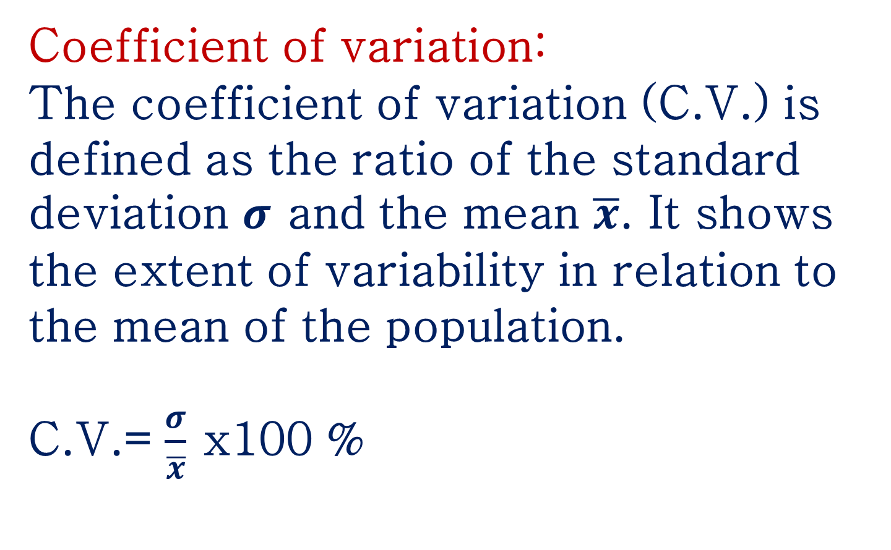
Coefficient of variation:
The coefficient of variation (C.V.) is defined as the ratio of the standard deviation $σ$ and the mean $\overline{x}$. It shows the extent of variability in relation to the mean of the population.
C.V.= $\frac{σ}{\overline{x}}$ x100 %

Slide 6
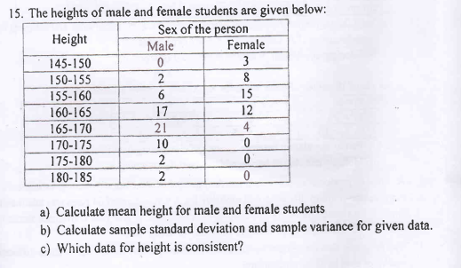

Slide 7
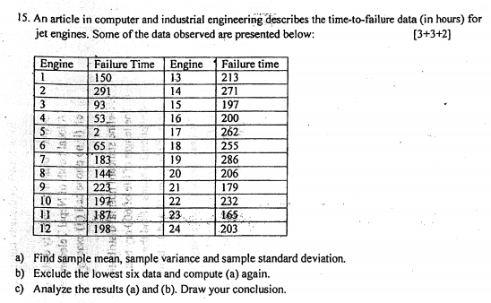

Slide 8
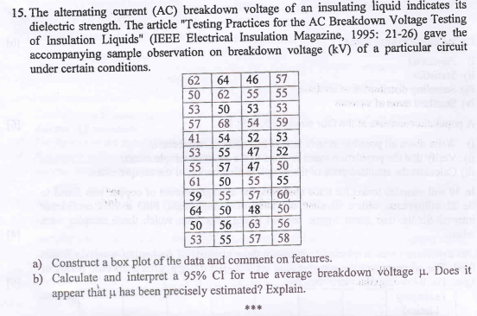

Slide 9
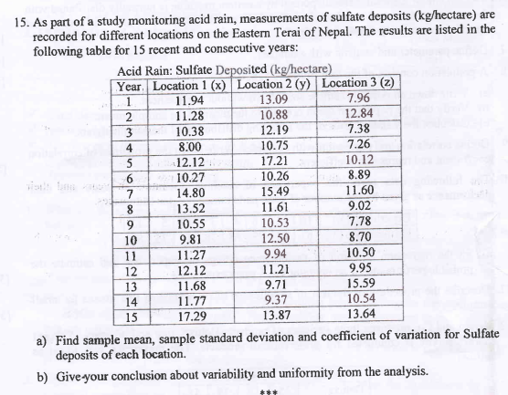

Slide 10
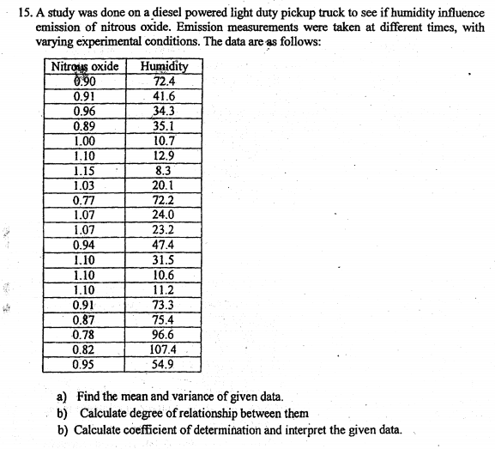

Slide 11
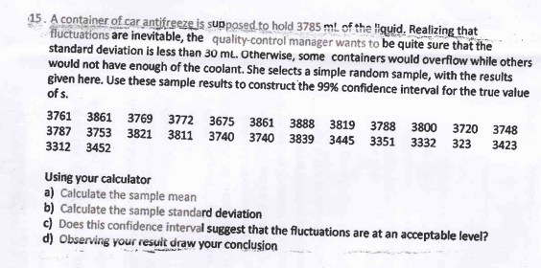

Slide 12
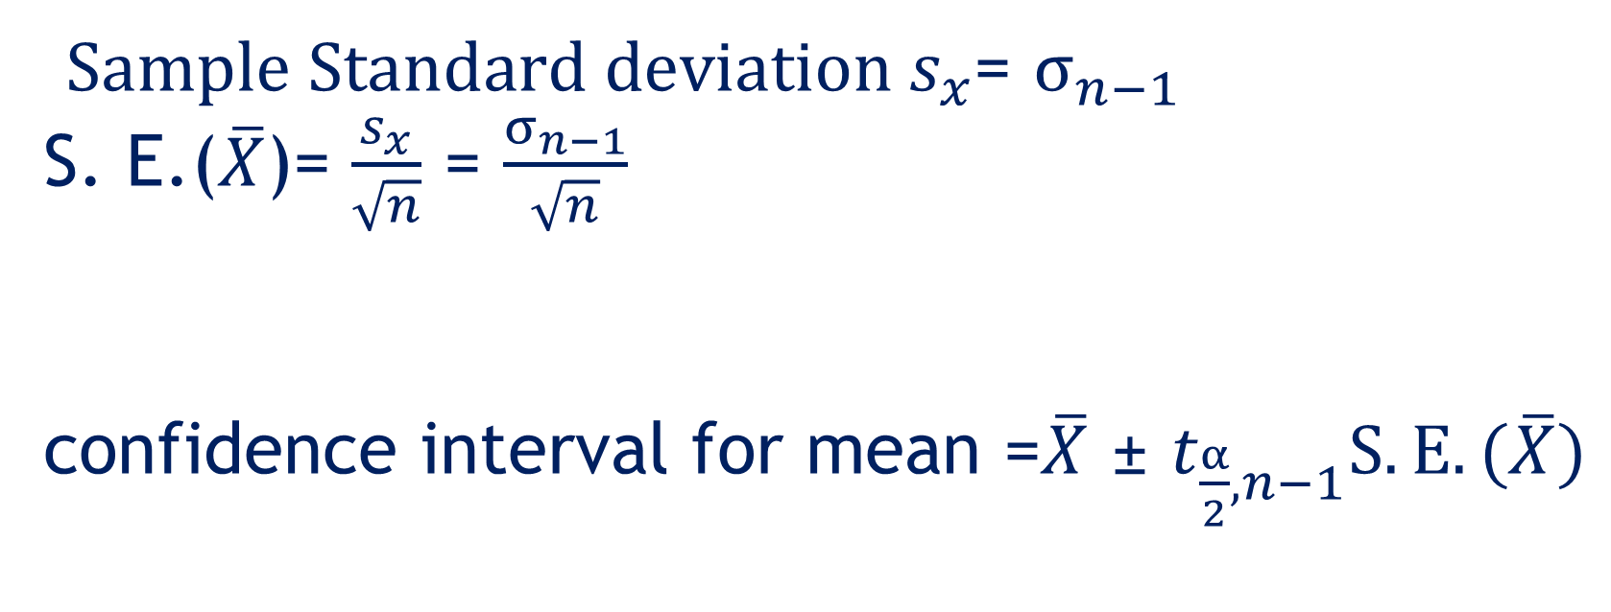
$Sample Standard deviation s_{x}$= $σ_{n−1}$
S. E.($\overline{X}$)= $\frac{s_{x}}{\sqrt{n}}$ = $\frac{σ_{n−1}}{\sqrt{n}}$ confidence interval for mean =$\overline{X}$ ± $t_{\frac{α}{2},n−1}S.E.(\overline{X})$

